Slide 1

Noida Institute of Engineering and Technology, Greater Noida
OBJECT ORIENTED TECHNIQUES USING JAVA(ACSE0302)
Unit: 4
Mr. Surya Prakash Sharma
Department CSE
Concurrency in Java and I/O Stream
Course Details
(B.Tech 3rd Sem /2nd Year)
Mr. Surya Prakash Sharma UNIT - 4 ACSE0302 OBJECT ORIENTED TECHNIQUES USING JAVA

Slide 2
UNIT CONTENT
Threads: Introduction and Types
  Creating Threads
  Thread Life-Cycle
  Thread Priorities
  Daemon Thread
  Runnable Class
  Synchronizing Threads
I/O Stream: Introduction and Types
  Common I/O Stream Operations
  Interaction with I/O Streams Classes
Annotations: Introduction
  Custom Annotations
  Applying Annotations
Dr. Ratna N Patil UNIT - 4 ACSE0302 OBJECT ORIENTED TECHNIQUES USING JAVA

Slide 3
Threads: Introduction
Threads
  Threads allows a program to operate more efficiently by doing multiple things at the same time.
  Threads can be used to perform complicated tasks in the background without interrupting the main program.
  Java is a multi-threaded programming language which means we can develop multi-threaded program using Java.
  A multi-threaded program contains two or more parts that can run concurrently, and each part can handle a different task at the same time making optimal use of the available resources specially when your computer has multiple CPUs.
  Multitasking is when multiple processes share common processing resources such as a CPU.
Mr. Surya Prakash Sharma UNIT - 4 ACSE0302 OBJECT ORIENTED TECHNIQUES USING JAVA

Slide 4
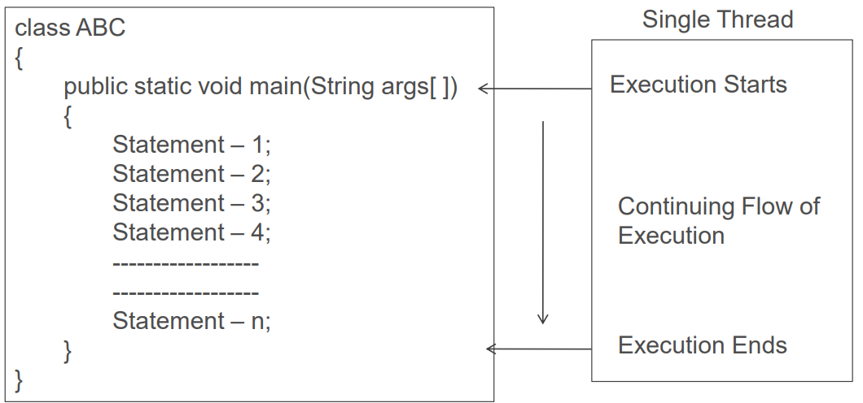
Threads: Introduction
Threads:
It is similar to a program that has single flow of control.
It has a beginning, a body and an end and execute commands sequentially.
All main program can be called single-threaded programs.
Mr. Surya Prakash Sharma UNIT - 4 ACSE0302 OBJECT ORIENTED TECHNIQUES USING JAVA

Slide 5
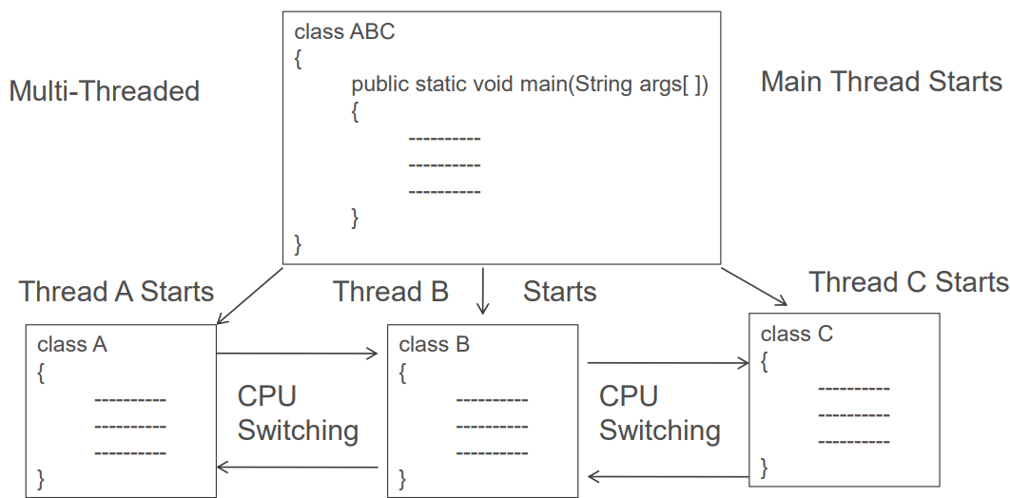
Threads: Introduction
Multi-Threading:
A program that contains multiple flow of control called multi threaded program.
Mr. Surya Prakash Sharma UNIT - 4 ACSE0302 OBJECT ORIENTED TECHNIQUES USING JAVA

Slide 6
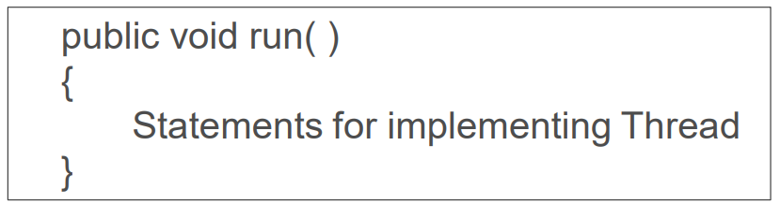
Creating a Threads
  Threads are implemented in form of a object containing a method called run().
  run() makes up entire body of thread and only a method that thread’s behavior can be implemented. It is invoked by the object of concerned thread.
  Thread is initiated using start( ) method
  A new thread can be implemented by two ways:
  By creating a thread class: by extends Thread class and override its run() method.
  By converting a class to a thread: by implements Runnable interface.
Mr. Surya Prakash Sharma UNIT - 4 ACSE0302 OBJECT ORIENTED TECHNIQUES USING JAVA

Slide 7
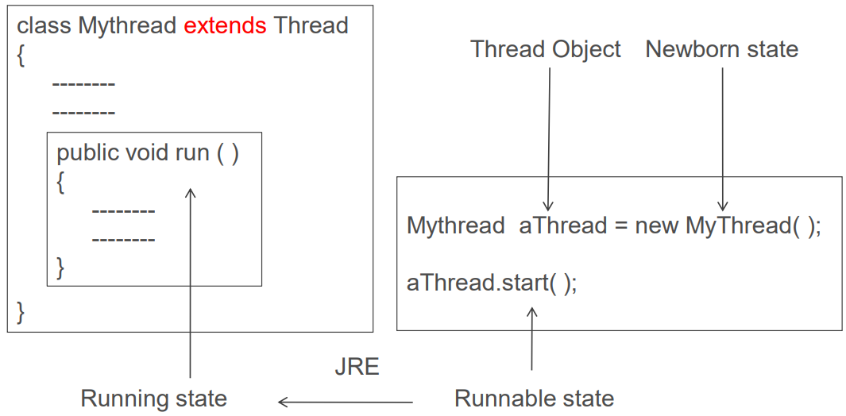
Extending Thread Class - overriding the run( )
Mr. Surya Prakash Sharma UNIT - 4 ACSE0302 OBJECT ORIENTED TECHNIQUES USING JAVA

Slide 8
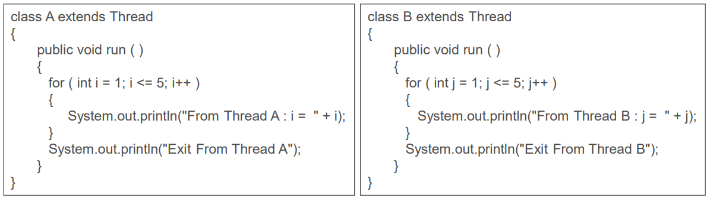
1. By creating a thread class
Mr. Surya Prakash Sharma UNIT - 4 ACSE0302 OBJECT ORIENTED TECHNIQUES USING JAVA

Slide 9
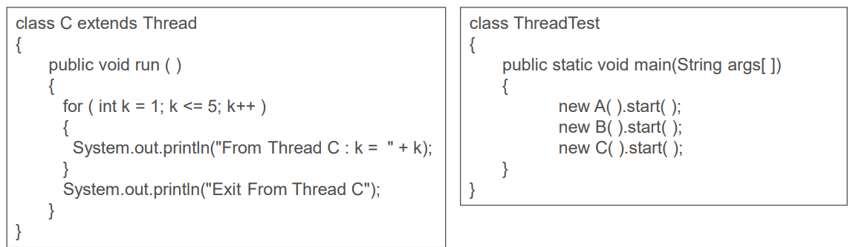
1. By creating a thread class
Mr. Surya Prakash Sharma UNIT - 4 ACSE0302 OBJECT ORIENTED TECHNIQUES USING JAVA

Slide 10
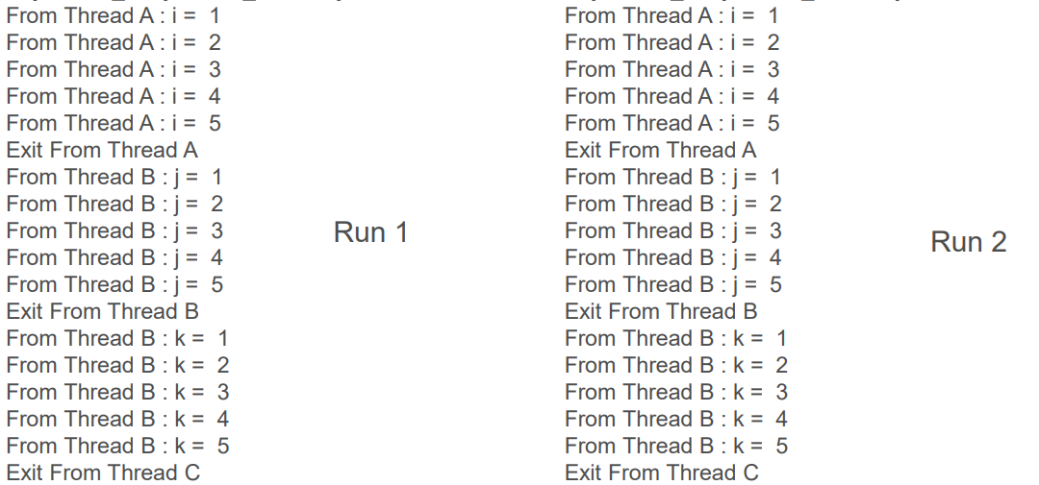
1. By creating a thread class(Output)
Mr. Surya Prakash Sharma UNIT - 4 ACSE0302 OBJECT ORIENTED TECHNIQUES USING JAVA

Slide 11
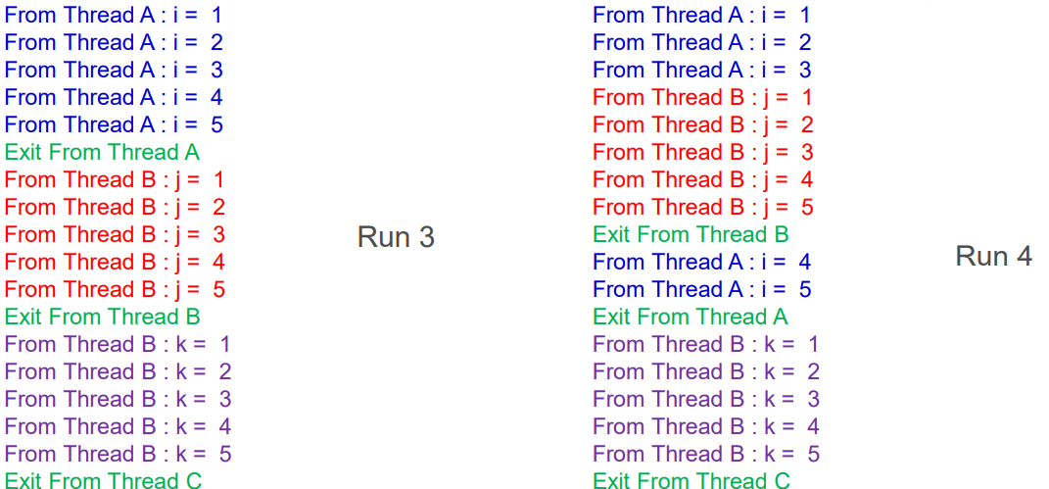
1. By creating a thread class(Output)
Mr. Surya Prakash Sharma UNIT - 4 ACSE0302 OBJECT ORIENTED TECHNIQUES USING JAVA

Slide 12
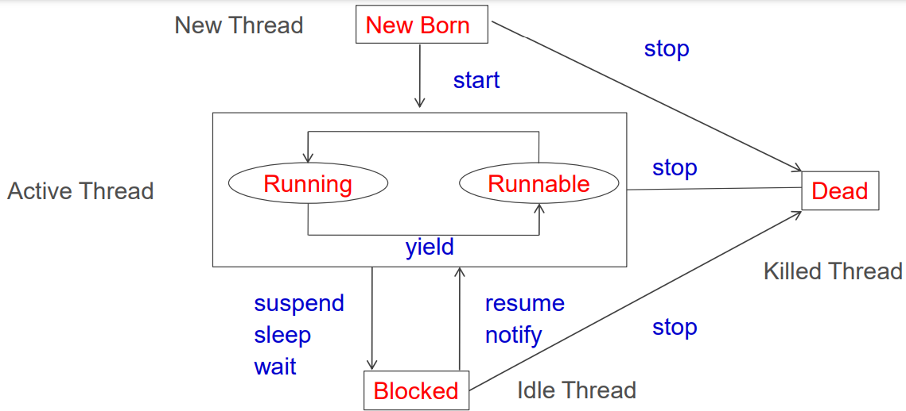
A Thread Life Cycle
java thread states
1. New
2. Runnable
3. Running
4. Blocked
5. Terminated
Mr. Surya Prakash Sharma UNIT - 4 ACSE0302 OBJECT ORIENTED TECHNIQUES USING JAVA

Slide 13
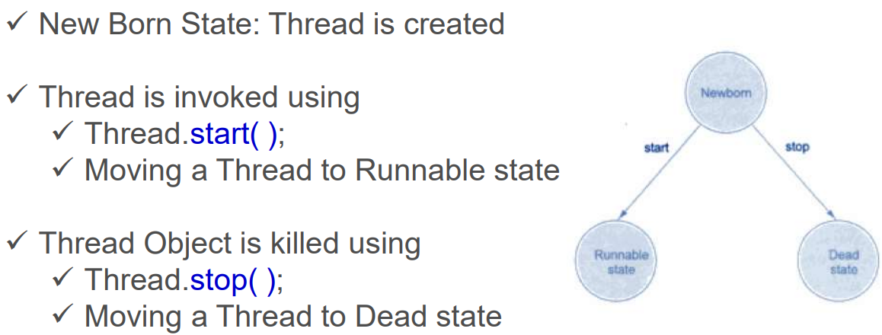
Thread states
Mr. Surya Prakash Sharma UNIT - 4 ACSE0302 OBJECT ORIENTED TECHNIQUES USING JAVA

Slide 14

Thread states
Runnable State
Thread is ready for execution
Thread is waiting in Queue to get CPU
Round Robin: Equal Time Slots for Threads with same Priorities
Thread.yield( ): Relinquish Control from Running Thread and move it to Runnable State Threads may be assigned Priorities
Threads are arranged based on Priorities
Mr. Surya Prakash Sharma UNIT - 4 ACSE0302 OBJECT ORIENTED TECHNIQUES USING JAVA

Slide 15
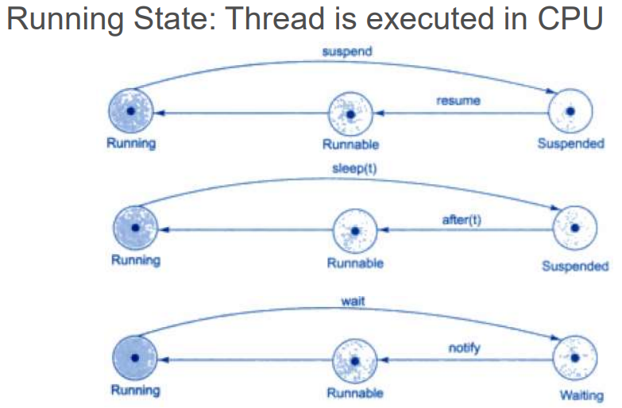
Thread states
Mr. Surya Prakash Sharma UNIT - 4 ACSE0302 OBJECT ORIENTED TECHNIQUES USING JAVA

Slide 16
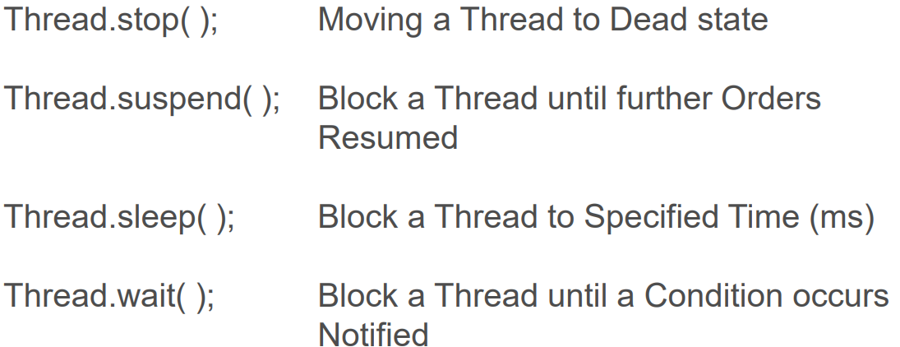
Thread states
Mr. Surya Prakash Sharma UNIT - 4 ACSE0302 OBJECT ORIENTED TECHNIQUES USING JAVA

Slide 17
Thread states
Blocked State
Dead State
Life of the Thread Ends
Thread Completes its execution
Thread is killed after
  New born
  Running/ Runnable
  Blocked
Satisfied requirements is
Thread is suspended,
Thread is sleeping
Thread is waiting
Mr. Surya Prakash Sharma UNIT - 4 ACSE0302 OBJECT ORIENTED TECHNIQUES USING JAVA

Slide 18
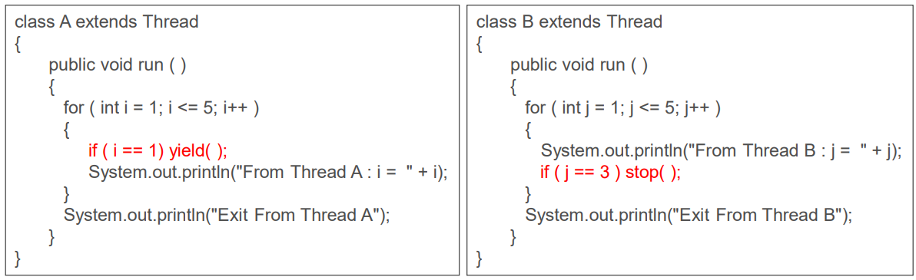
Thread Program using sleep(), yield(),stop() methods
Mr. Surya Prakash Sharma UNIT - 4 ACSE0302 OBJECT ORIENTED TECHNIQUES USING JAVA

Slide 19
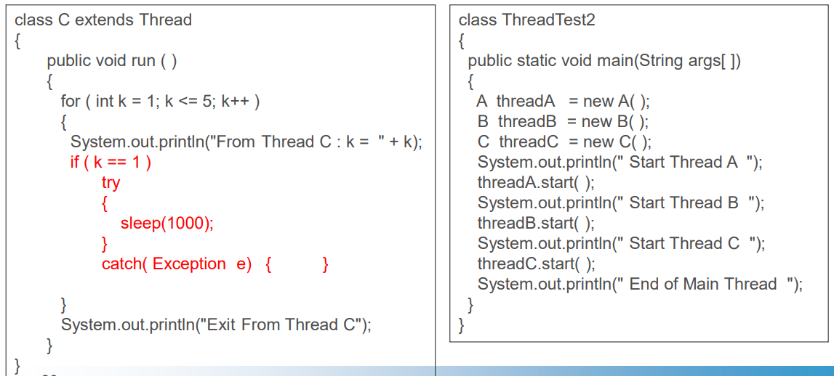
Thread Program using sleep(), yield(),stop() methods
Mr. Surya Prakash Sharma UNIT - 4 ACSE0302 OBJECT ORIENTED TECHNIQUES USING JAVA

Slide 20
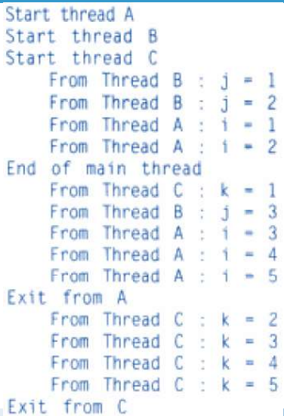
Thread Program Output
Mr. Surya Prakash Sharma UNIT - 4 ACSE0302 OBJECT ORIENTED TECHNIQUES USING JAVA

Slide 21
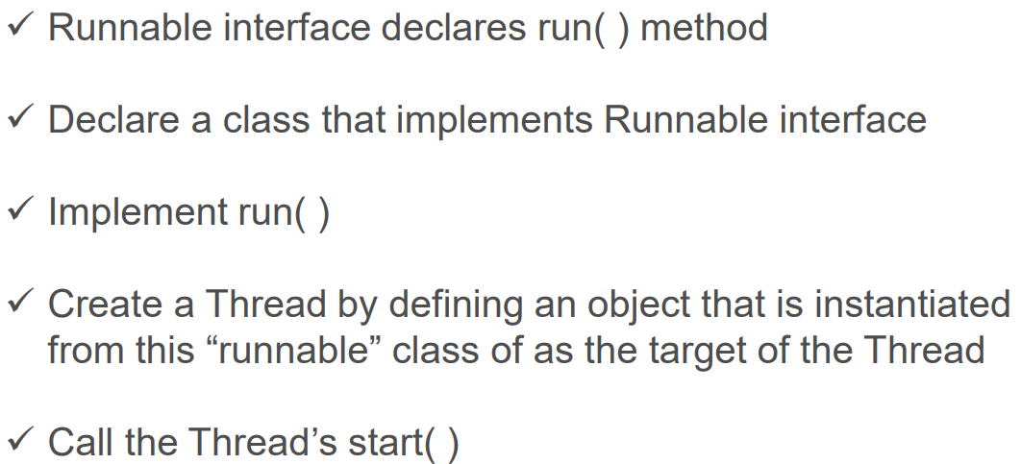
Implementing Runnable Interface
Mr. Surya Prakash Sharma UNIT - 4 ACSE0302 OBJECT ORIENTED TECHNIQUES USING JAVA

Slide 22
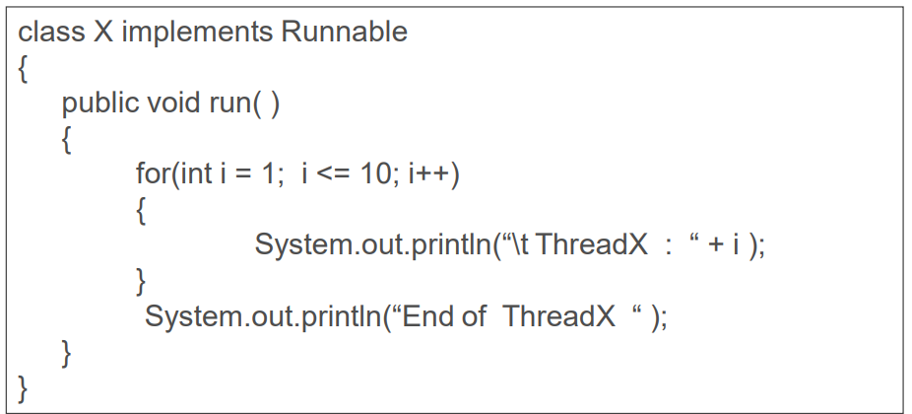
Implementing Runnable Interface
Mr. Surya Prakash Sharma UNIT - 4 ACSE0302 OBJECT ORIENTED TECHNIQUES USING JAVA

Slide 23
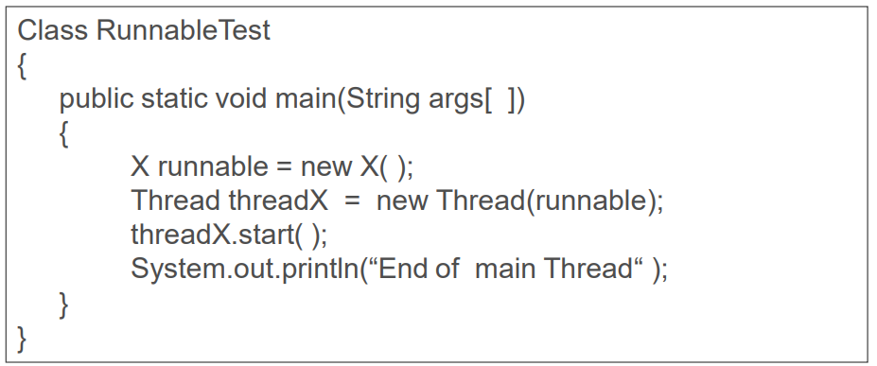
Implementing Runnable Interface
Mr. Surya Prakash Sharma UNIT - 4 ACSE0302 OBJECT ORIENTED TECHNIQUES USING JAVA

Slide 24
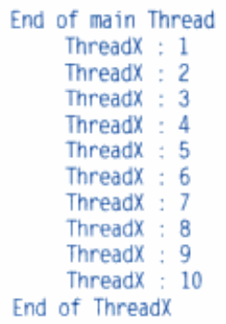
Thread by Runnable Interface
Mr. Surya Prakash Sharma UNIT - 4 ACSE0302 OBJECT ORIENTED TECHNIQUES USING JAVA

Slide 25
Thread Priorities
Java thread priorities are in the range between MIN_PRIORITY (a constant of 1) and MAX_PRIORITY (a constant of 10). By default, every thread is given priority NORM_PRIORITY (a constant of 5).
Threads with higher priority are more important to a program and should be allocated processor time before lower-priority threads.
However, thread priorities cannot guarantee the order in which threads execute and are very much platform dependent.
Mr. Surya Prakash Sharma UNIT - 4 ACSE0302 OBJECT ORIENTED TECHNIQUES USING JAVA

Slide 26
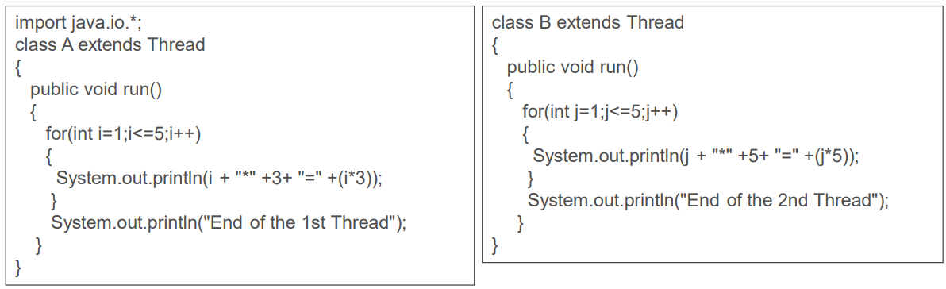
Thread Priorities
Mr. Surya Prakash Sharma UNIT - 4 ACSE0302 OBJECT ORIENTED TECHNIQUES USING JAVA

Slide 27
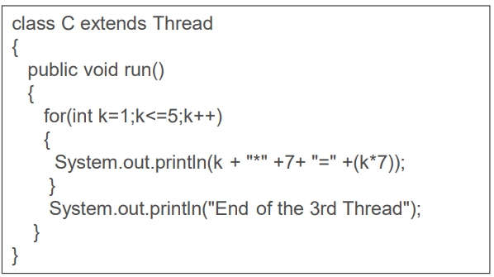
Thread Priorities
Mr. Surya Prakash Sharma UNIT - 4 ACSE0302 OBJECT ORIENTED TECHNIQUES USING JAVA

Slide 28
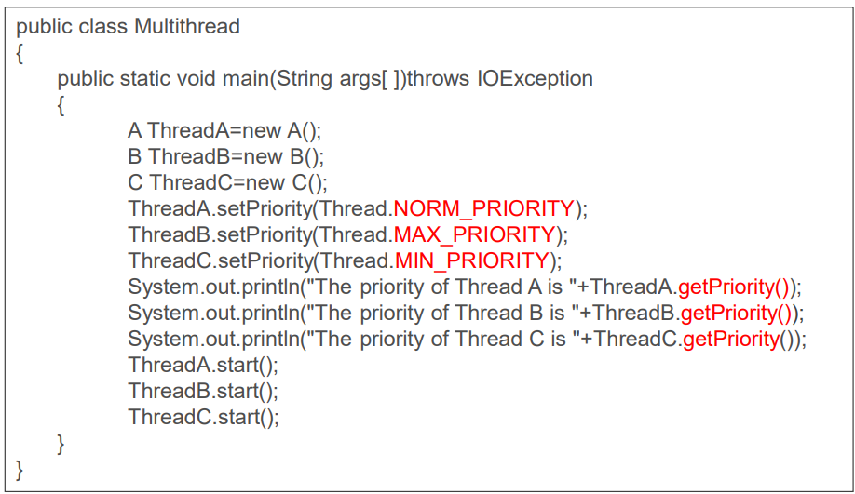
Thread Priorities
Mr. Surya Prakash Sharma UNIT - 4 ACSE0302 OBJECT ORIENTED TECHNIQUES USING JAVA

Slide 29
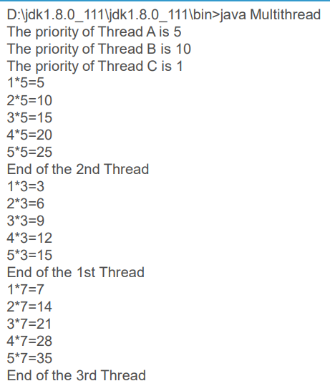
Thread Priorities
Mr. Surya Prakash Sharma UNIT - 4 ACSE0302 OBJECT ORIENTED TECHNIQUES USING JAVA

Slide 30
Daemon Thread
Daemon thread in java is a service provider thread that provides services to the user thread.
Its life depend on the mercy of user threads i.e. when all the user threads dies, JVM terminates this thread automatically.
There are many java daemon threads running automatically e.g. gc, finalizer etc.
Points to remember for Daemon Thread in Java
  It provides services to user threads for background supporting tasks. It has no role in life than to serve user threads.
  Its life depends on user threads.
  It is a low priority thread.
Mr. Surya Prakash Sharma UNIT - 4 ACSE0302 OBJECT ORIENTED TECHNIQUES USING JAVA

Slide 31
Daemon Thread
Methods for Java Daemon thread by Thread class
  The java.lang.Thread class provides two methods for java daemon thread.
No. | Method | Description
1) | public void setDaemon(boolean status) | is used to mark the current thread as daemon thread or user thread.
2) | public boolean isDaemon() | is used to check that current is daemon.
Mr. Surya Prakash Sharma UNIT - 4 ACSE0302 OBJECT ORIENTED TECHNIQUES USING JAVA

Slide 32
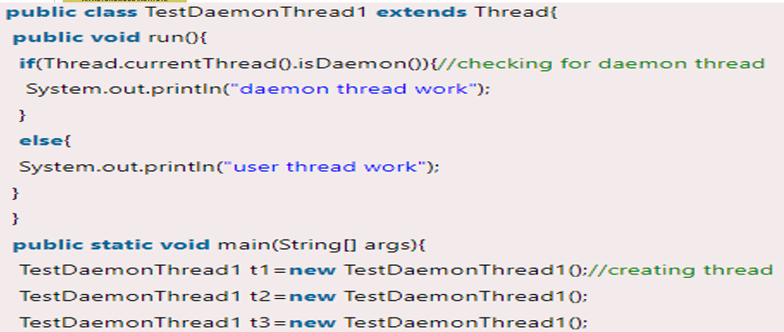
Daemon Thread Example
Mr. Surya Prakash Sharma UNIT - 4 ACSE0302 OBJECT ORIENTED TECHNIQUES USING JAVA

Slide 33

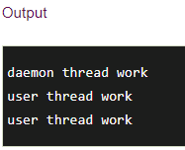
Daemon Thread Example
Mr. Surya Prakash Sharma UNIT - 4 ACSE0302 OBJECT ORIENTED TECHNIQUES USING JAVA

